Slide 1
Design Patterns

Slide 2
Design Patterns
Object oriented programming was basically introduced to ease the development process as well as reduce the time of development by reducing amounts of code. If properly planned and designed, OOP can increase the performance of the program to a great extent. One of those magical performance cum code reduction issues is "Design Pattern" which was introduced by Eric Gamma and his three other friends in the book Design Patterns in 1972. Because of four authors, the book was introduced as written by Gang of Four or simply Goff. In that legendary book, Gang of Four introduced several patterns to minimize the amount of code as well as to introduce effective coding practice.
You Might have Done this Before…
While coding, many of us use these patterns without being aware that these techniques are actually known as patterns. Even in my early coding life, I used some coding techniques, which I later found out to be similar to some patterns. So don't be afraid about using patterns. They are daily coding tricks, which you may have always performed, but you may not have known.
While developing software, some problems are addressed on a regular basis. Almost every software development faces some of these problems. These problems are termed "design patterns" and are given some common solutions. So knowing design patterns saves a lot of time for developers in software development. Let's have a closer look at design patterns.

Slide 3
Singleton Pattern
The main purpose of the Singleton pattern is to deliver a single instance of object no matter how many times you instantiate it.
This saves memory consumption by preventing the creation of multiple instances of an object.
Singleton pattern is used to improve the performance of your application.

Slide 4
Strategy Pattern
Strategy pattern is a common pattern helps us make decisions on different cases, more easily.

Slide 5
Factory Pattern
The main goal of this pattern is delivering an object by hiding all the complexities behind it.

Slide 6
Abstract Factory
Provides an interface for creating families of related or dependent objects without specifying their concrete classes.
As long as concrete objects are derived from a known abstract object, programming is simplified because they all come in the same standard.

Slide 7
Adapter Pattern
Adapter is actually an object that acts like an adapter in real life, in that it converts one thing to another. Using Adapter you can convert electric sources from higher to lower volts.
Similarly in OOP, using Adapter pattern, one object can fit for the same methods of another object.

Slide 8
Iterator Pattern
Iterators are very useful to provide an easy interface to manipulate a collection sequentially.

Slide 9
Observer Pattern
An Observer pattern solves a common problem in OOP. For example, if you want some objects to be notified automatically when something happens (an event raised), you can solve that problem with this pattern.
An Observer pattern consists of two types of objects; one is an observable object, which is observed by observer object. When the state of an observable object changes, it notifies all observers registered with it.

Slide 10
Proxy Pattern (Lazy Loading)
Another very important programming practice in OOP is lazy loading and loose coupling.
The main idea is to decrease the concrete dependency among objects while coding.
It always increases the portability of your code.
Using the Proxy pattern you can create a local version of a remote object. It provides a common API for accessing methods of a remote object without knowing the things behind the scene.
The best example of a Proxy pattern could be the XML RPC and SOAP client and server for PHP.

Slide 11
Decorator Pattern
Using this pattern you can add additional functionalities in an existing object without extending an object.
To extend an object, sometimes you need to know many inner things of that class. Sometimes it's not possible to extend the class without rewriting the existing functionalities.

Slide 12
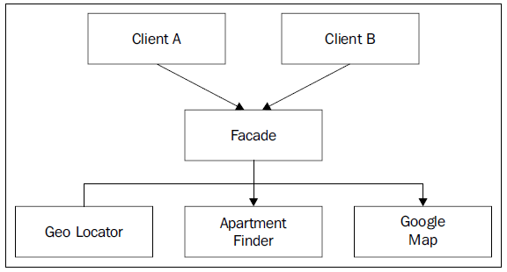
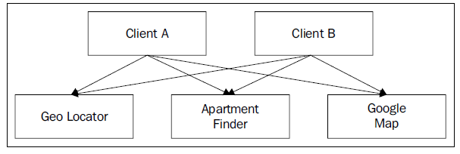
Facade Pattern
Facade provides a common interface to many objects.
It just simplifies the programming providing a necessary interface, which actually uses a lot of other objects behind the scenes.
Thus it minimizes the learning curve for developers.

Slide 13
Conclusion
Design patterns are an essential part of OOP. It makes your code more effective, better performing, and easier to maintain.
Don't think that you have to implement design pattern in your code. Use them only when you need them.
Proper usage of correct patterns can make your code perform better; similarly using them improperly could make your code slow and less efficient.
Best of Luck & Happy Coding ☺ --------------------- Nazmul Basher Head of Development Field Nation

